Slide 1
Computer Vision for Industrial Safety: Binary Image Classification for Helmet Compliance Detection
Computer VisionHelmNet
Austin University – Post Graduate Program in Artificial Intelligence
2026-05-14

Slide 2
Contents / Agenda
Data Overview
Exploratory Data Analysis
Data Pre-processing
Convolutional Neural Network (CNN) from Scratch
Transfer Learning with VGG-16 (Base)
Transfer Learning with VGG-16 (Base + FFNN)
Transfer Learning with VGG-16 (Base + FFNN + Data Augmentation)
Model Performance Comparison and Final Model Selection

Slide 3
Executive Summary
We compared four models on 4,125 worker photos (76.6% With Helmet / 23.4% Without). For a safety use case, Recall for the "Without Helmet" class is our critical metric. Failing to detect an unsafe worker (a false negative) carries the highest operational risk, making recall the ultimate measure of the model's safety value.
Key Finding
Model 1 wins on both recall and F1
best at catching unsafe cases without flooding users with false alerts. Counter-intuitively, the simple CNN outperformed all VGG-16 transfer-learning variants, likely because it learned features specific to this dataset.
Status & Recommendation
Model 1 catches ~85% of "Without Helmet" workers on the test set — strong as a prototype, not yet safety-grade. Before production:
Enrich Data - Collect more "Without Helmet" images.
Optimize Thresholds – Lower, from the decision threshold to raise recall.
Iterate - Try fine-tuning VGG-16's top layers.
Deploy with a human-in-the-loop for borderline cases.
Apply class weighting (class_weight={0: 3.3, 1: 1.0}) to penalize no-helmet misses more during training.
Lower – Classification Threshold to output from > 0.5 to > 0.35 makes the model more conservative converting some FP into true detection.
Model | Recall | F1
CNN from Scratch (Model 1) | 0.860 | 0.880
VGG-16 Base (Model 2) | 0.812 | 0.824
VGG-16 + FFNN (Model 3) | 0.729 | 0.770
VGG-16 + FFNN + Aug (Model 4) | 0.647 | 0.678

Slide 4
Business Problem Overview and Solution Approach
Problem Overview
SafeGuard Corp operates in hazardous industrial environments where workers are exposed to safety risks from falling objects, machinery, and active construction or industrial activity. Safety helmets are a critical form of protection, but monitoring helmet compliance manually is difficult to scale across large worksites and multiple camera feeds.
The business problem is that manual monitoring can be inconsistent, time-consuming, and prone to human error. As a result, workers who are not wearing helmets may go undetected, increasing the risk of workplace injury and non-compliance with safety procedures.
As a data scientist at SafeGuard Corp, the objective is to develop an image classification model that can classify workplace images into two categories:
With Helmet: Workers wearing safety helmets. Without Helmet: Workers not wearing safety helmets.
This is a binary image classification problem. The goal is to prepare a model that can support a future automated safety monitoring system by identifying possible helmet non-compliance from images or video frames.

Slide 5
Business Problem Overview and Solution Approach
Problem Overview
SafeGuard Corp operates in hazardous industrial environments where workers are exposed to safety risks from falling objects, machinery, and active construction or industrial activity. Safety helmets are a critical form of protection, but monitoring helmet compliance manually is difficult to scale across large worksites and multiple camera feeds.
The business problem is that manual monitoring can be inconsistent, time-consuming, and prone to human error. As a result, workers who are not wearing helmets may go undetected, increasing the risk of workplace injury and non-compliance with safety procedures.
As a data scientist at SafeGuard Corp, the objective is to develop an image classification model that can classify workplace images into two categories:
With Helmet: Workers wearing safety helmets. Without Helmet: Workers not wearing safety helmets.
This is a binary image classification problem. The goal is to prepare a model that can support a future automated safety monitoring system by identifying possible helmet non-compliance from images or video frames.

Slide 6
Business Problem Overview and Solution Approach
Problem Overview
Context
Maintaining safety standards in high-risk industrial environments and construction sites is essential to mitigate severe head injuries and fatalities.
Operational Inefficiencies
Traditional manual compliance checks are highly prone to human error, fail to scale effectively, and cannot provide constant monitoring over massive sites.
The Bottom Line
Non-compliance significantly escalates corporate legal, financial, and operational risks. Automating safety verification provides non-stop, scalable monitoring to maximize regulatory compliance and protect workforce health.
.

Slide 7
Business Problem Overview and Solution Approach
Problem Overview
Context
Maintaining safety standards in high-risk industrial environments and construction sites is essential to mitigate severe head injuries and fatalities.
Operational Inefficiencies
Traditional manual compliance checks are highly prone to human error, fail to scale effectively, and cannot provide constant monitoring over massive sites. It is impossible for humans supervisors to be every where in the
The Bottom Line
Non-compliance significantly escalates corporate legal, financial, and operational risks. Automating safety verification provides non-stop, scalable monitoring to maximize regulatory compliance and protect workforce health.
.
Solution Approach
As a data scientist at SafeGuard Corp, I developed a binary image classification approach using a structured computer vision workflow. The methodology includes dataset exploration, image preprocessing, class imbalance analysis, baseline CNN development, transfer learning with VGG-16, model performance comparison, and final model selection based on safety-relevant metrics such as recall, precision, F1-score, and confusion matrix results. Recall as a lead indicator handles the class imbalance fairly, while accuracy may lead to heavy overfit, because the dataset exhibit a significant class imbalance.

Slide 8
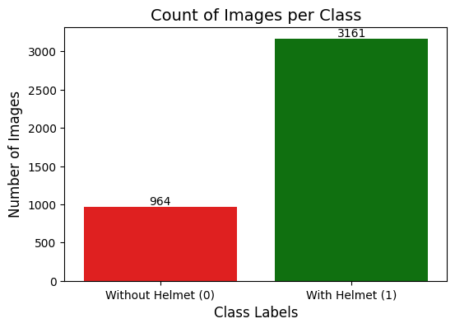
Data Overview
Dataset Scale
4,125 total field images at 200x200 pixels, 0-255
Target Classification
With Helmet(class 1): Workers correctly wearing safety helmets.
Without Helmet(class 0): Active Safety non-compliance, workers without helmet.
Class Balance
3,161 with helmet(76.6%) and 964 Without Helmet(23.4%) a great imbalance of 3.3:1
KPI Alignment
For SafeGuard Corp, a False Negative—failing to flag a worker who is Without a Helmet—is a costly and dangerous model failure. Our core metric must emphasize maximizing Recall for the minority class.

Slide 9
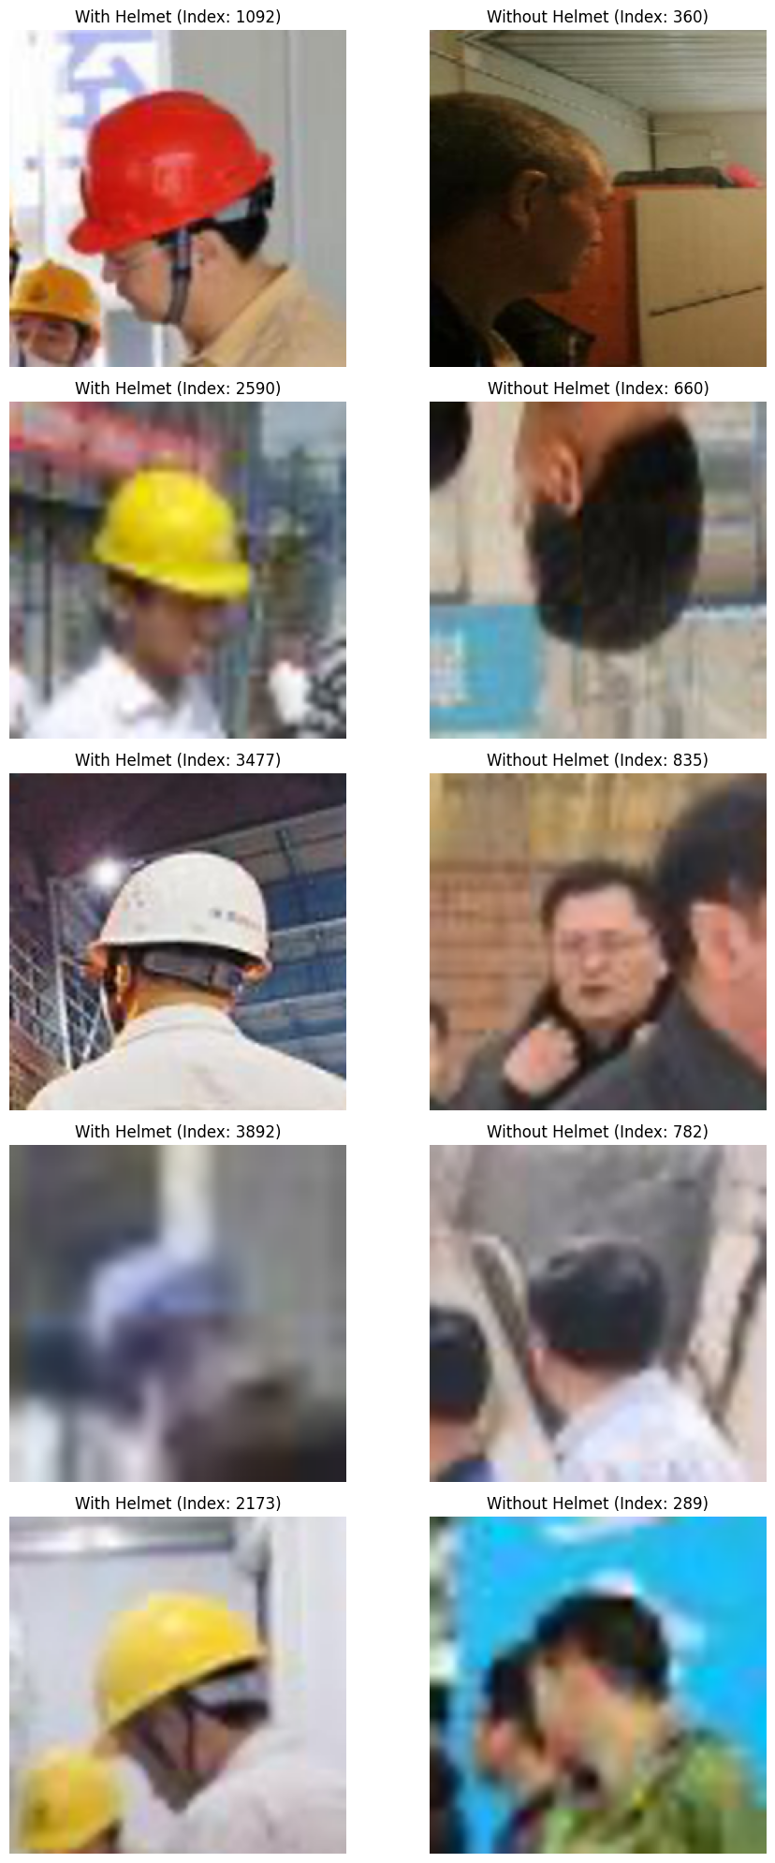
Exploratory Data Analysis
Class Balance
3,161 with helmet(76.6%) and 964 Without Helmet(23.4%) a great imbalance of 3.3:1
Environmental Issues
Images reflect real-world site conditions containing diverse construction and factory environments, shifting lighting scales,Variable camera angles, and real worker postures.
Worker Mobility
Images reflect real-world site conditions, workers are sometimes stading, other times actively operating heavy machinery or tools, or moving across the field of view.
Image Quality
Images often include dark hair, hats, or partial heads – sometimes a confusable feature for a model. Some picture are sharp, some heavily blured see the pallet, and yet some are cropped close to the head.
Implication
A Small from scratch model may match or beat a deep pretained network, since the task signal(helmet x no helmet) is narrow and visually consistent.

Slide 10
Data Pre-processing
Dataset Split
70% Train, 15% Validation, 15% Test, preserving the 76.6/23.4 class ratio in each subset.
If it was a large dataset we could split 80/10/10, which is also a common method in the market
Image
We enforced images to 200 x 200 x 3 channels to normalize downstream computation.
Normalization
We cast the pixel value to float32 and divided by 255.0, scaling intensities to [0,1] for stable gradient updates. Keeping the value small and consistent helps neural network, otherwise number like 255, 128, 0 are to far away.
Label Treatment
We kept it as binary {0,1}; no resampling, or class weights applied at this stage
Augmentation
Augmentation was only introduced at model 4; earlier models train on raw normalized images.
Metric Choice
A custom function computes Accuracy, Precision, Recall, and F1 with average=“macro, avoiding majority-class bias.

Slide 11
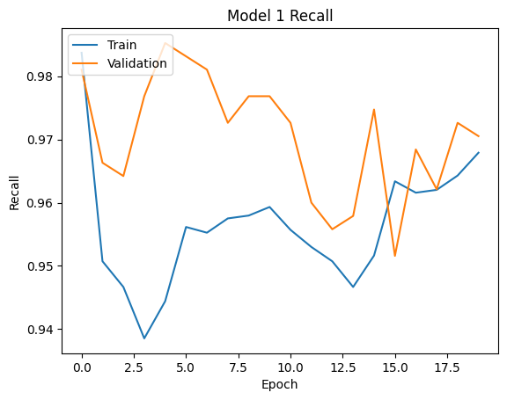
Convolutional Neural Network (CNN) from Scratch
Model 1
Architecture
Performance
Convolution Blocks
Conv2d(16, 3x3)
MaxPool(4x4)
Conv2D(32,3x3)
MaxPool(2x2)
Conv2D(64, 3x3)
Head
Flatten
Dense(4, ReLU)
Dense(1, Sigmoid)
Optimizer
Adam (lr = 0.001)
Loss
Binary cross-entropy
Tracked Metric
Recall
Training
20 epochs, batch size 32
Train Validation
Accuracy 0.960 0.919
Recall 0.936 0.860
Precision 0.951 0.906
F1 Score 0.943 0.880
Notes
This is the best of the four models. The F1(which measures recall and precision) gap is only 0.06, it generalizes well.
From the graphic we can tell that the model is adjusting quickly in the first few epochs as it learns the data pattern.
It performs well on unseen validation data
It is effective at reducing missed detection

Slide 12
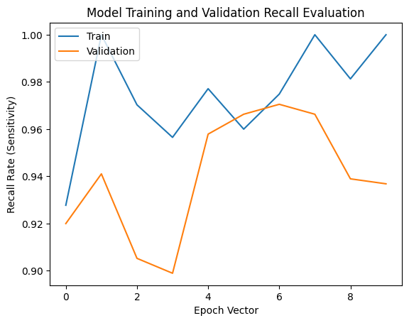
Transfer Learning with VGG-16 (Base)
Model 2
Architecture
Performance
Foundation
VGG-16 pretrained no ImageNet, all convolutional layers frozen
Head
Flatten
Dense(1, Sigmoid)
Optimizer
Adam (lr = 0.001)
Loss
Binary cross-entropy
Tracked Metric
Recall
Training
10 epochs, batch size 32
No data augmentation
Train Validation
Accuracy 0.965 0.879
Recall 0.939 0.812
Precision 0.963 0.838
F1 Score 0.950 0.824
Notes
This model trains fast and fits the training set well, but generalization is worse than model 1. The f1 gap is 0.13. Imagenet features are too generic for this task.
The validation falls from 0.92 to around 0.90 by epoch 3 meaning the model initially struggles to generalize
Gap between training and validation recall widens, this is a potential sign of overfitting. The model is becoming very good on training but less on validation data

Slide 13
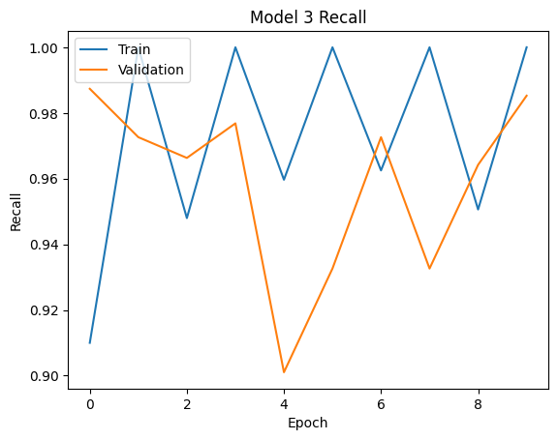
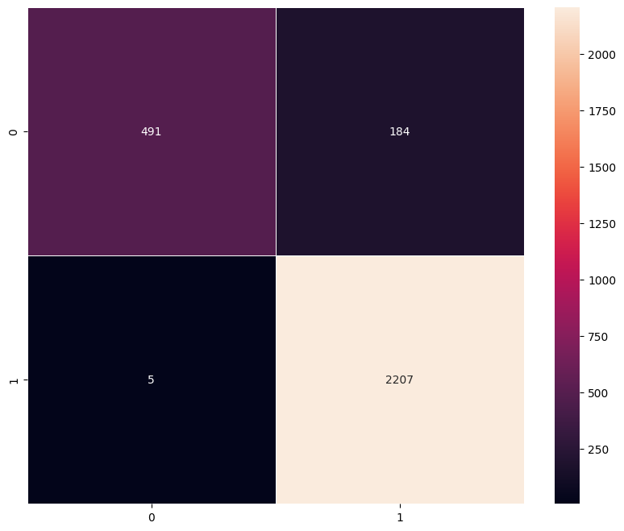
Transfer Learning with VGG-16 (Base + FFNN)
Model 3 – With Feed Forward Neural Network
Architecture
Performance
Foundation
VGG-16 pretrained no ImageNet, all convolutional layers frozen
Head
Flatten
Dense(256, ReLU)
Dropout(0.3)
Dense(64, ReLU)
Dense(1, Sigmoid)
Optimizer
Adam (lr = 0.001)
Loss
Binary cross-entropy
Tracked Metric
Recall
Training
10 epochs, batch size 32
No data augmentation
Deeper head to more complex feature combination
Train Validation
Accuracy 0.935 0.866
Recall 0.863 0.729
Precision 0.956 0.883
F1 Score 0.899 0.770
Notes
Model 3 achieves consistently high recall on both training and validation sets. It is effective at detecting workers with Helmet.
Looking at the confusion matrix of this model we can see that it has 184 false positives. That means it sometimes predicts class 1(with Helmet) when the actual class is 0. This catastrophic for the company compliance and great safety risk.

Slide 14
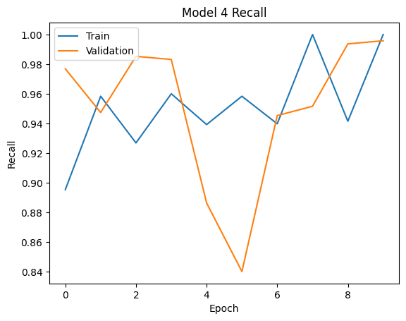
Transfer Learning with VGG-16 (Base + FFNN + Data Augmentation)
Model 4 – With Feed Forward Neural Network
Architecture
Performance
Foundation + Head
Same as model 3
Augmentation
Rotation +-20⁰
Width/height shift 0.1
Shear 0.1
Zoom 0.1
Fill=“nearest”
Optimizer
Adam (lr = 0.001)
Loss
Binary cross-entropy
Tracked Metric
Recall
Training
10 epochs, batch size 32
Data augmentation training set only, validation and test clean
Deeper head to more complex feature combination
Train Validation
Accuracy 0.861 0.834
Recall 0.705 0.647
Precision 0.915 0.890
F1 Score 0.748 0.678
Notes
Smallest training – validation gap but lowest absolute scores F1= 0.678. Augmentation distorts the helmet signal more than it helps generalize
Validation recall starts high at 0.98 the model initially generalizes well to validation data.
Validation drops sharply between 4 and 5, temporarily fial to generalize
Train and validation as too misaligned. It is somewhat volatile

Slide 15
Model Performance Comparison and Final Model
Selection
Validation Performance – Orange is best
Model Acc Recall Prec F1 Gap
CNN from Scratch (Model 1) 0.919 0.860 0.906 0.880 0.063
VGG-16 Base (Model 2) 0.879 0.812 0.838 0.824 0.126
VGG-16 + FFNN (Model 3) 0.866 0.729 0.883 0.770 0.129
VGG-16 + FFNN + Aug (Model 4) 0.834 0.647 0.890 0.678 0.070
Final Selection – Model 1 – CNN from Scratch
Best overall performer. It has the highest F1-score, recall, precision, and even accuracy, with a relative low gap on training – validation (0.063). Model1 provides the best balance between correctly identifying helmet compliance patterns and limiting false prediction. It is important to recall that false predictions have high compliance risk and may damage the companies reputation.
The model perform well, it is lean, give it or take 160K params, it is easier to deploy on hardware near cameras.
Test performance (held-out 619 images): Accuracy 0.908, Recall 0.854, Precision 0.882, F1 0.867 — close to validation, confirming the model generalizes.

